Slide 1


Slide 2
Database Management Systems
Week 4, Day 4
MongoDB
Atta Muhammad
+92-333-1971110
attapanhyar@quest.edu.pk

Slide 3

MongoDB
MongoDB is a document database.
It stores data in a type of JSON format called BSON
A record in MongoDB is a document, which is a data structure composed of key value pairs like the structure of JSON objects.
Notes:
JSON stands for JavaScript Object Notation

Slide 4
SQL vs Document Databases
SQL
SQL databases are considered relational databases.
They store related data in separate tables. When data is needed, it is queried from multiple tables to join the data back together.
MongoDB
MongoDB is a document database which is often referred to as a non-relational database.
This does not mean that relational data cannot be stored in document databases.
It means that relational data is stored differently. A better way to refer to it is as a non-tabular database.

Slide 5
MongoDB
MongoDB stores data in flexible documents.
Instead of having multiple tables you can simply keep all your related data together.
This makes reading your data very fast.
In MongoDB, instead of tables these are called collections.

Slide 6
Local vs Cloud Database
MongoDB can be installed locally, which will allow you to host your own MongoDB server on your hardware.
This requires you to manage your server, upgrades, and any other maintenance.

Slide 7
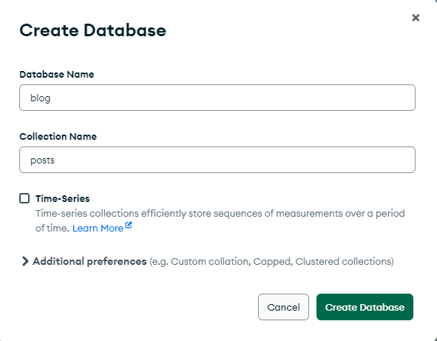
Creating a Database

Slide 8
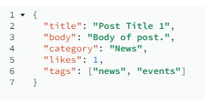
MongoDB Document
Records in a MongoDB database are called documents
and the field values may include numbers, strings, booleans, arrays, or even nested documents.

Slide 9
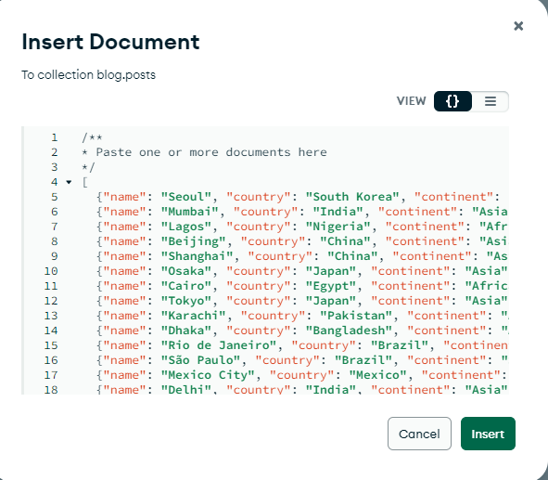
Inserting a document

Slide 10
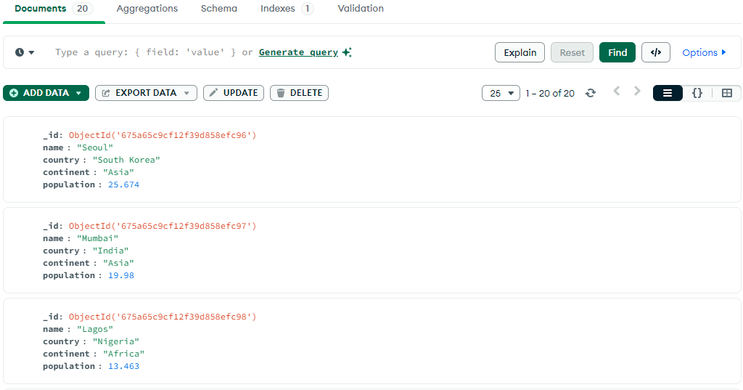
Collection Status

Slide 11
Navigating and Filtering the Data
MongoDB Compass is a convenient tool for browsing through the data stored in a MongoDB database through a graphical interface.
It removes the burden of having to remember the names of obscure databases or collections, and you can navigate to any database or collection on your MongoDB server with just a few clicks.

Slide 12
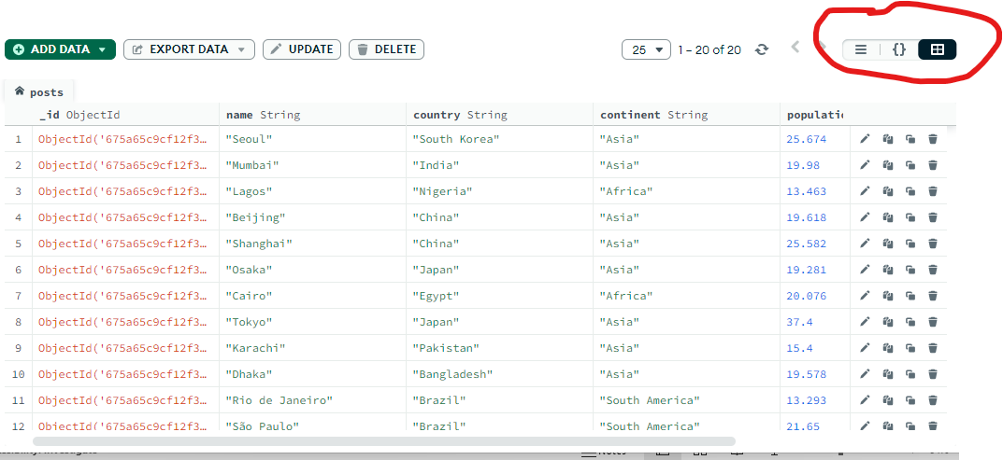
View data in collection

Slide 13
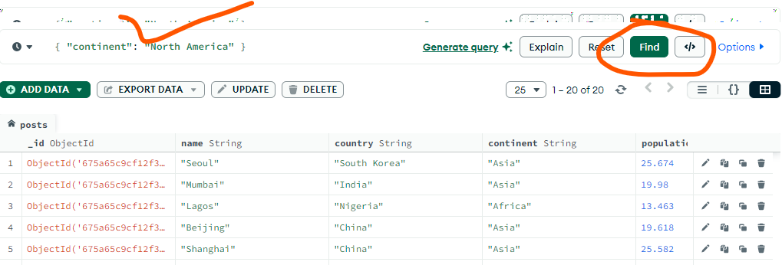
Find()

Slide 14
Aggregation Pipeline Builder
Compass’s aggregation pipeline builder is a graphical tool aiding with the creation of multi-step aggregation pipelines

Slide 15
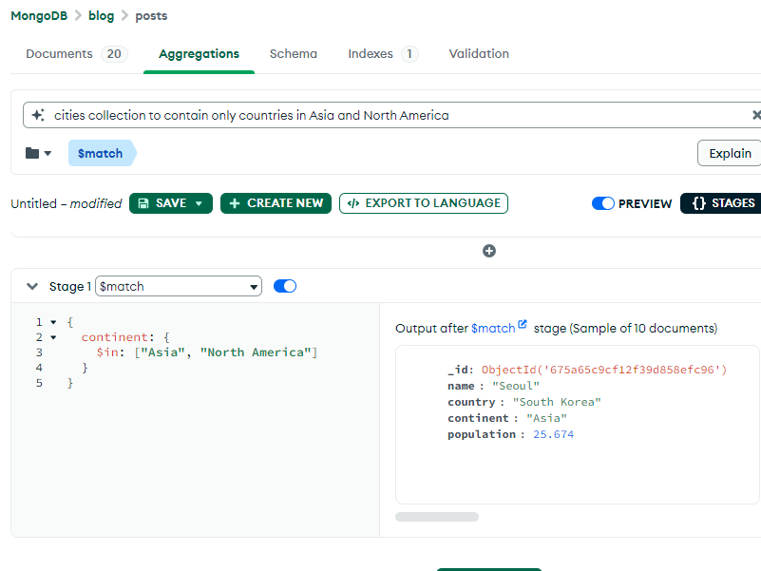

Slide 16
Question(s)

